Slide 1
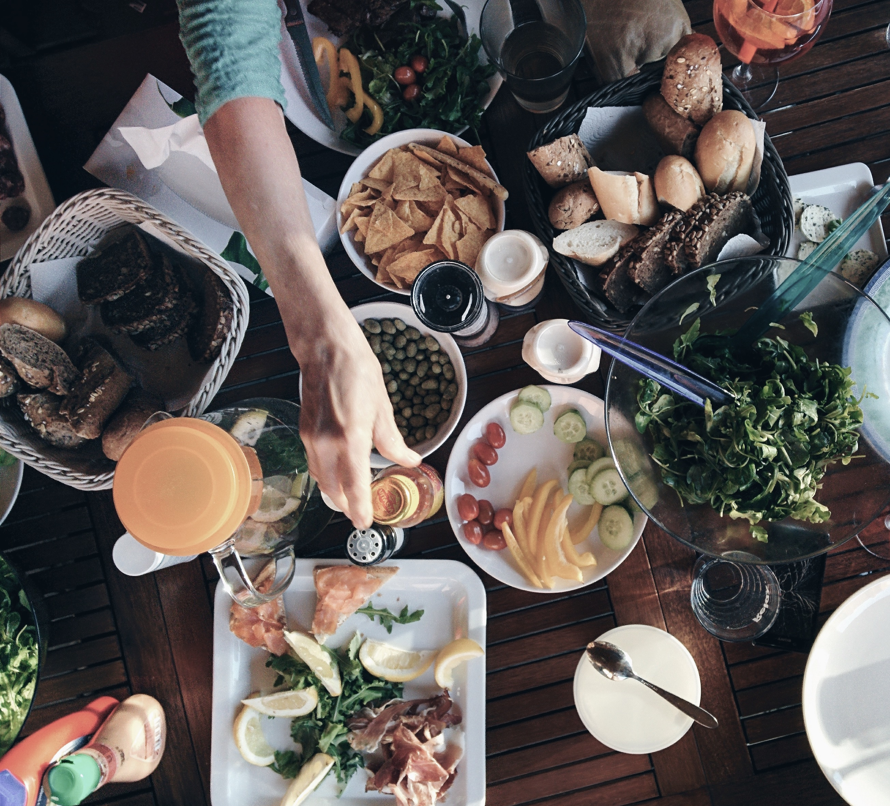
Enaak! Cuisine Prediction
1071 Data Science Practice _ Final Project
106753015 吳明倫
106753040 柳桓任

Slide 2
Input
Dataset / Data preprocessing

Slide 3
Dataset
Json data from kaggle “what’s cooking”
train.json
20 cuisines, 39775 recipes, 6677 ingredients
test.json
9944 recipes, 4465 ingredients
{
"id": 10259,
"cuisine": "greek",
"ingredients": [
"romaine lettuce",
"black olives",
"grape tomatoes",
"garlic",
"pepper",
"purple onion",
"seasoning",
"garbanzo beans",
"feta cheese crumbles"
]
}
{
"id": 18009,
"ingredients": [
"baking powder",
"eggs",
"all-purpose flour",
"raisins",
"milk",
"white sugar"
]
}
Notes:
*Our recipe data does not contain method of cooking (ex. boiling)
*kaggle data from yummly.com , we guess the user of yummly maybe western people. if using other website based on asian, maybe there has different results on amount of recipe by different cuisine.

Slide 4
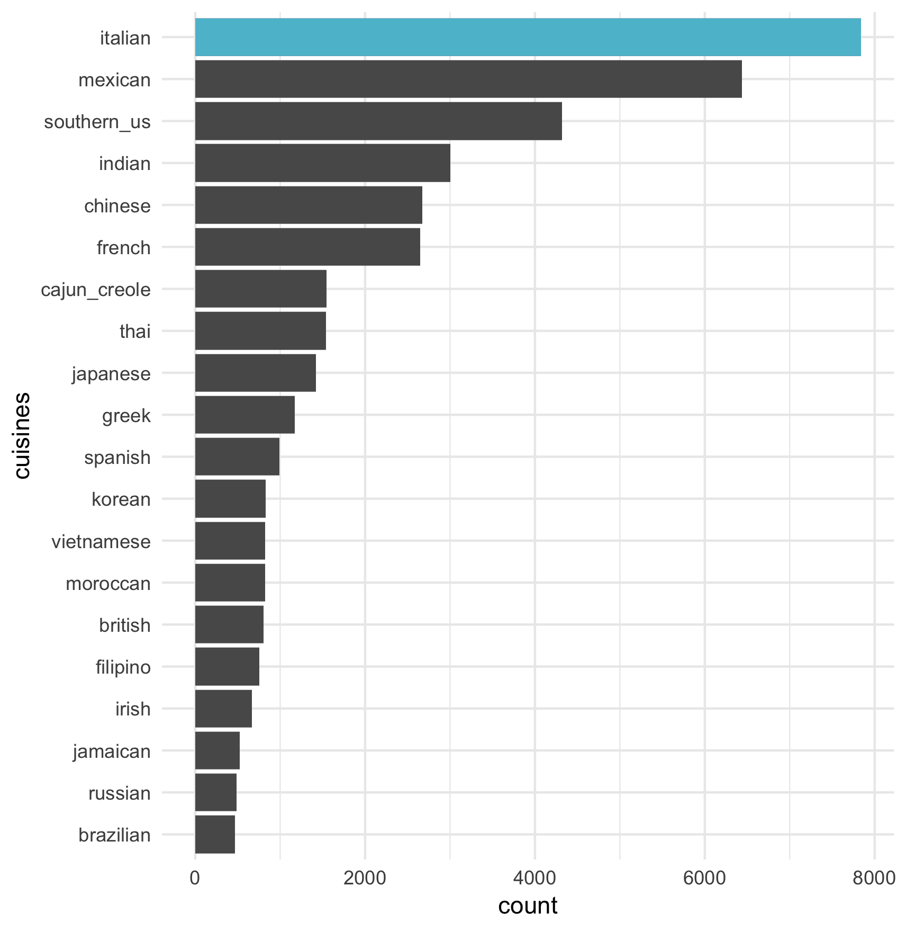
Early approach - What’s wrong?
Step1. Clean data
To lowercase
Delete quantifier
Step2. Null model
Predict all recipes as “italian”
Step3. Multiclass model
Any algorithm has same Recall 0.2
Random forest, Decision tree, kNN, SVM, Naïve bayes(0.12)
They are all classified as italian like our null model
Notes:
允許太多special case （ex. Brand name, states ;grinded etc）
Italian 43
Mexican 40
Southern us 36
Indian 24.9
Chinese 26.8
*French 31.4%
cajun 23
Thai 20
Japan 21
Greek 17
spanish 18.9
Korean 13
Vietnam 16
Moroccan 14
British 17
Fillipino 14
Irish 15
Jamaican 13
Russian 13
Brazilian 12

Slide 5
Data preprocessing
Cleaning
To lowercase
Removing non-ingredients term
Demonstrating ingredient state in which after comma ( , )
“english muffins, split and toasted” ; texture, preprocessing of ingredients
Quantifier
“(14 oz.) sweetened condensed milk” ; Oz. , lb. , ounc,
Special characters ; ®, &
“Oreo ® cookies”, “1% low-fat milk”
Inside parentheses
“asafetida(power)”
Apostrophes
“Soft goat’s cheese”
Notes:
發現允許太多special case （ex. Brand name, states ;grinded etc）
Boiled, shredded, chopped
High- , low-, %

Slide 6
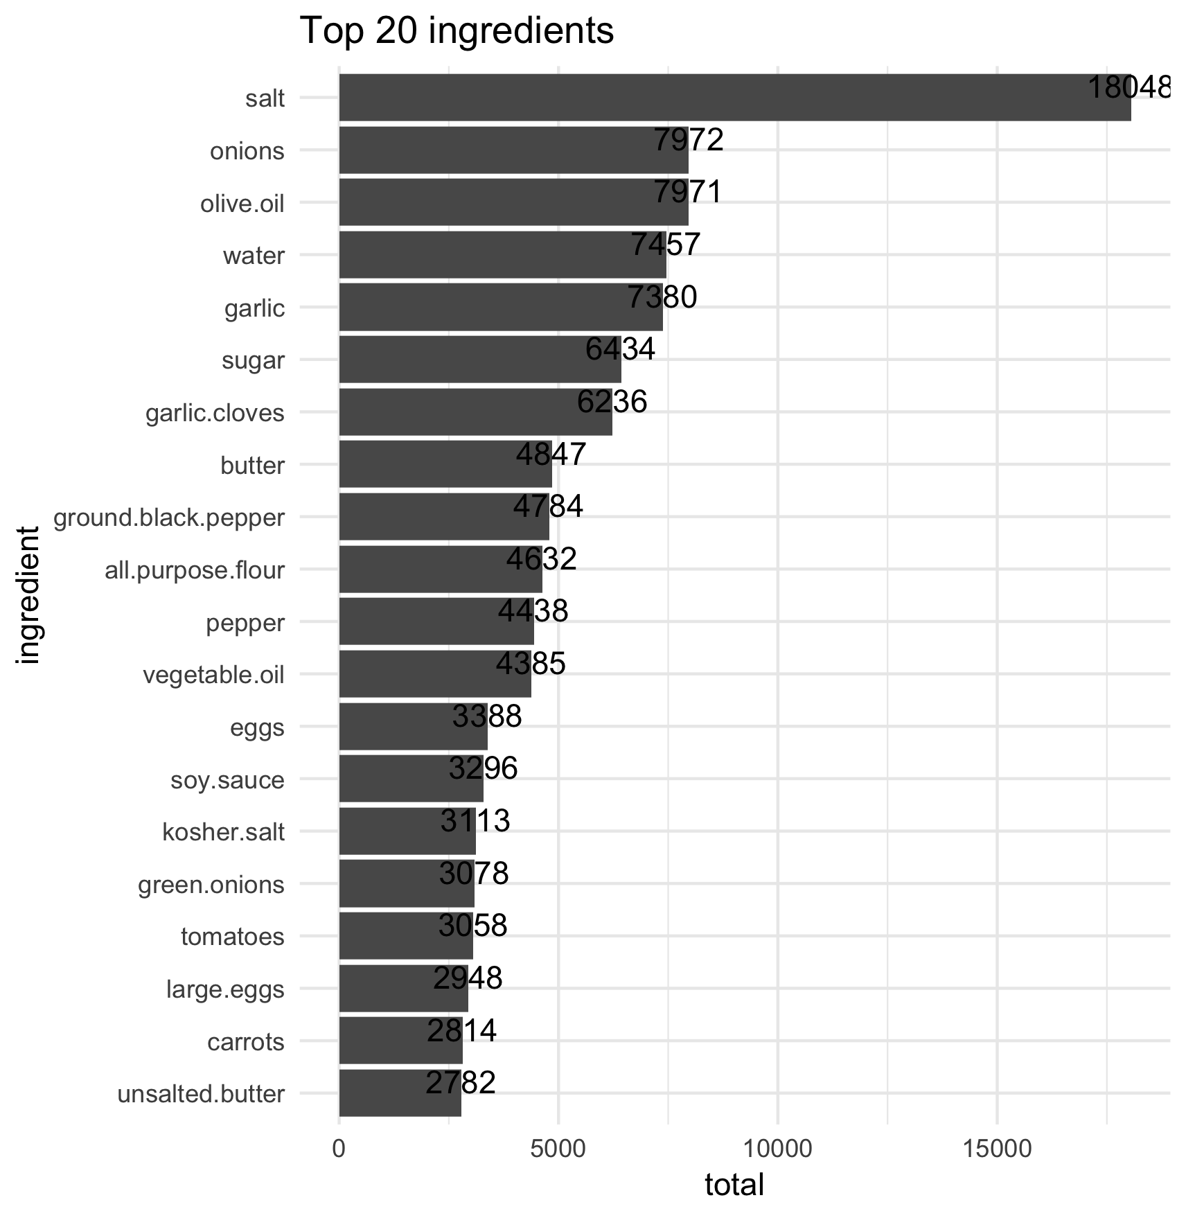
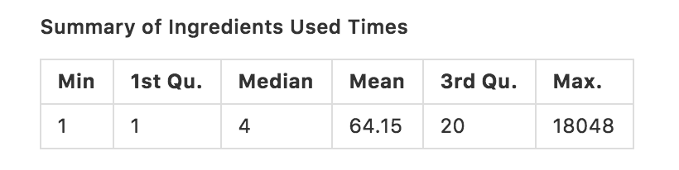
How to select feature
Which parameters we want to tune?
Used times of ingredients in full dataset
Can we use scientific insight?
Difference between Minimum and maximum in distribution
Around the median?
Result as threshold
Under 5

Slide 7
How to select feature
Which parameters we want to tune?
Amount of ingredients in a recipe
Can we use scientific insight?
Remove rare situation
Result as threshold
Before 2 and behind 30
Notes:
https://en.wikipedia.org/wiki/Skewness

Slide 8
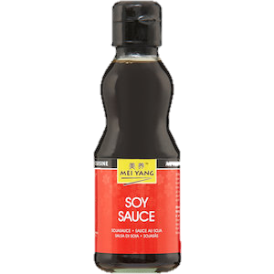
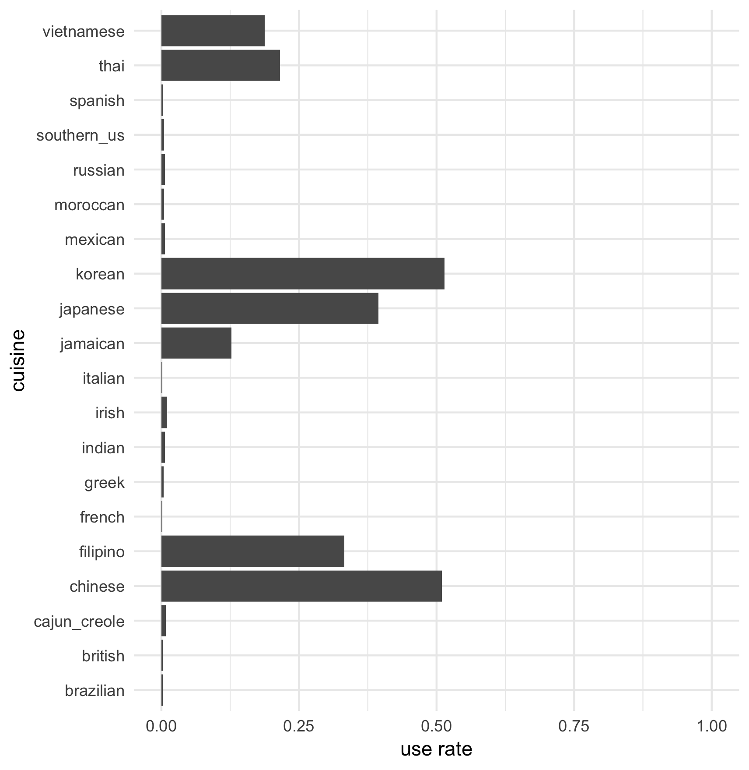
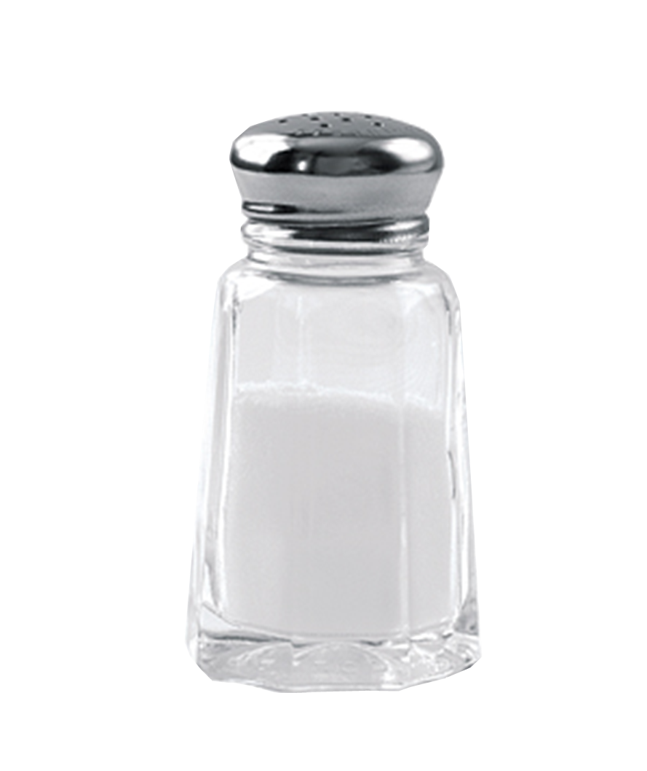
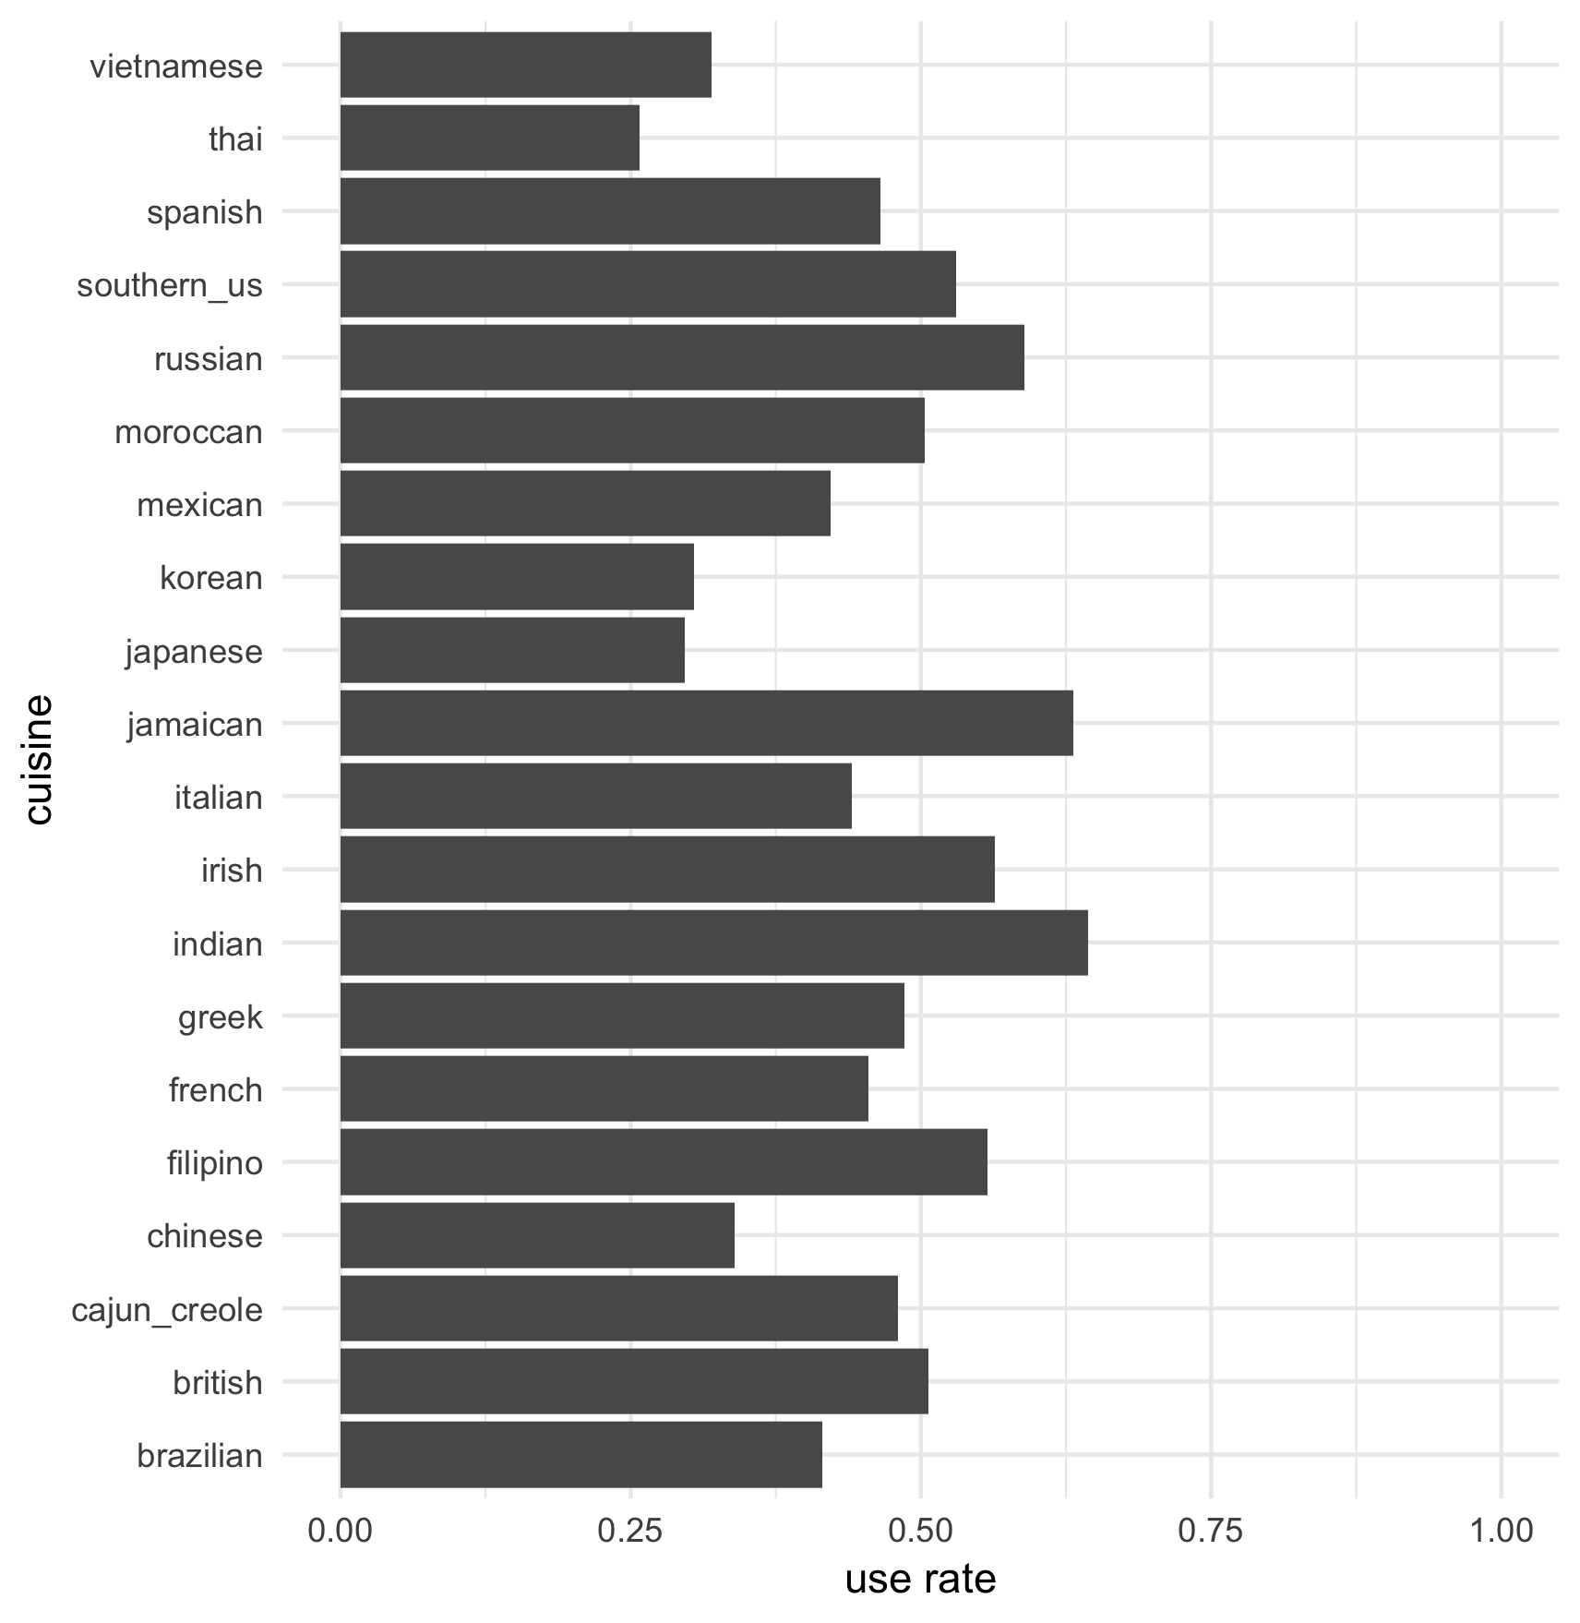
How to select feature
Which parameters we want to tune?
Proportion of ingredients in each cuisine
Is that Special ingredient Outlier?
Special ingredient : only appears in one cuisine
Can we use scientific insight?
“Entropy”
Less cuisine use, more important!
It has various aspect that proportion of one ingredient in each cuisine, depends on ingredient
The smaller the difference in the distribution ratio, the larger the entropy
Results as threshold
Over 3.8
Notes:
2. 각 레시피별 재료갯수
計算Top 20 ingredients 在每個cuisine中的佔比(%)，若在每種cuisine中佔比差不多，則可視為非重要feature而排除(to remove non-importance ingredient )

Slide 9
Modeling
Naïve bayes / Model flow

Slide 10
Selecting Algorithm
Naïve Bayes
Early try : 0.12
Lowercase, erase”,”
The number of ingredients : 6000
After data preprocessing : 0.68
Data cleaning, distribution of ingredient in a recipe
Compared with others, decision tree 0.20 svm 0.37 random forest 0.5x
After tuning : 0.73
The number of ingredients : 2000
We can see the power of data preprocessing
Notes:
Italian 43
Mexican 40
Southern us 36
Indian 24.9
Chinese 26.8
*French 31.4%
cajun 23
Thai 20
Japan 21
Greek 17
spanish 18.9
Korean 13
Vietnam 16
Moroccan 14
British 17
Fillipino 14
Irish 15
Jamaican 13
Russian 13
Brazilian 12

Slide 11
Model flow
test
Data preprocessing
Input
Cross validation
train
10 fold
model
Feature extraction
Amount in all data
Naïve Bayes
Amount in a recipe
entropy
result
output

Slide 12
Output
Performace / Challenge

Slide 13
performance
Recall
（cuisine that our model predicts correctly） / （cuisine that must be predicted correctly）
Result
Notes:
A divided by B

Slide 14
Challenge
Can we improve without text mining?
Entropy
Bigger dataset
It spends much more time
It can’t run when we use One hot encoding
Dataset format
Json to data frame
HUNGRY!!
Notes:
Topic
Only use technique what we have ever learned
Memory 被消耗完了 exhuasted
Json semistructured data

Slide 15
Demo
Replace our work / Reference

Slide 16
Reproduce our work
https://github.com/1071-DataScience/finalproject-106753015
Command line to explore Entropy
Rscript code/entropy.R --train "data/input format/train.Rdata" --entropy 3.5 --output data/entropy/drop_e3.5.txt
Rscript code/entropy.R --train "data/input format/train.Rdata" --entropy 3.8 --output data/entropy/drop_e3.8.txt
Rscript code/entropy.R --train "data/input format/train.Rdata" --entropy 4.0 --output data/entropy/drop_e4.0.txt
Rscript code/entropy.R --train "data/input format/train.Rdata" --entropy 4.2 --output data/entropy/drop_e4.2.txt
Notes:
Used lots oftime to generate result, so we choose entropy ,
If you want reproduce all our work, you can go link and follow instructure in readme
Will be dropped from our dataset, cuz too common to be used all cuisines

Slide 17
Reference
Recipe
A big data approach to computational creativity
Recipe recommendation using ingredient networks
Kissing cuisines: exploring worldwide culinary habits on the web
A neural network system for transformation of regional cuisine style
Model
IoT Sentinel: Automated Device-Type Identification for Security Enforcement in IoT

Slide 18

Q&A
Any question?

